Slide 1



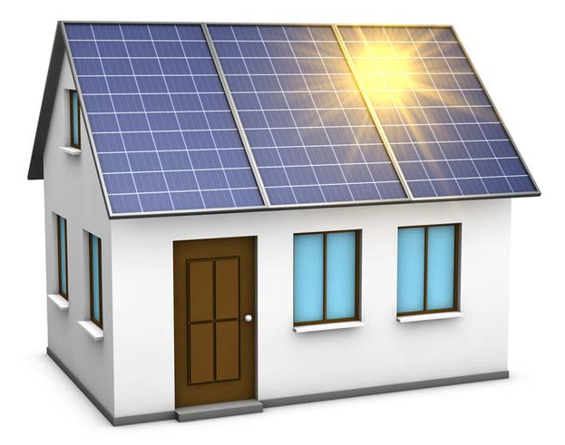





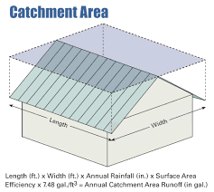
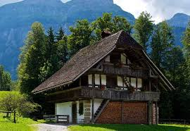
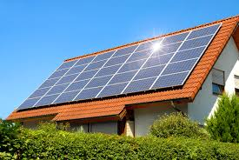

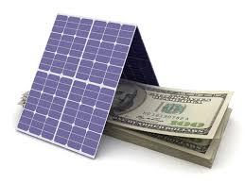


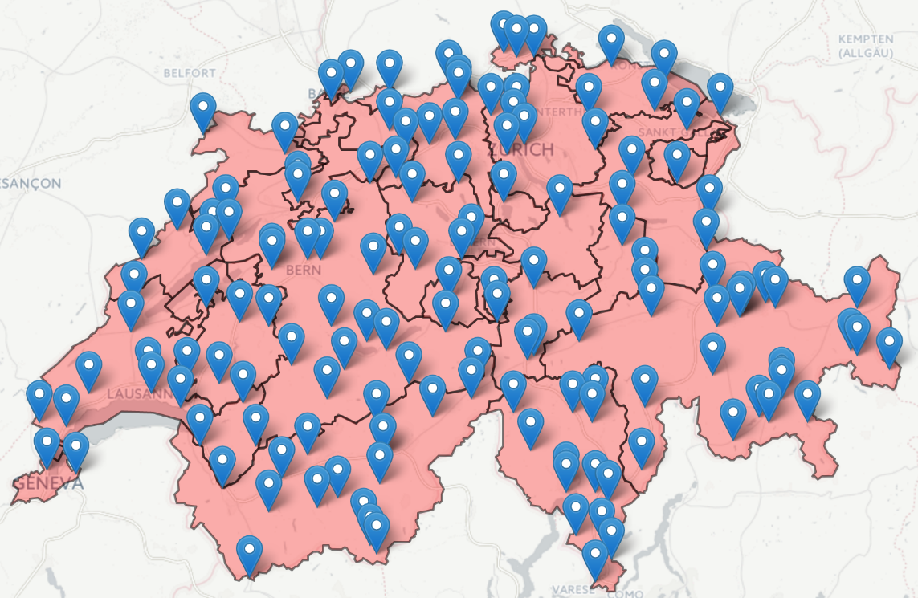



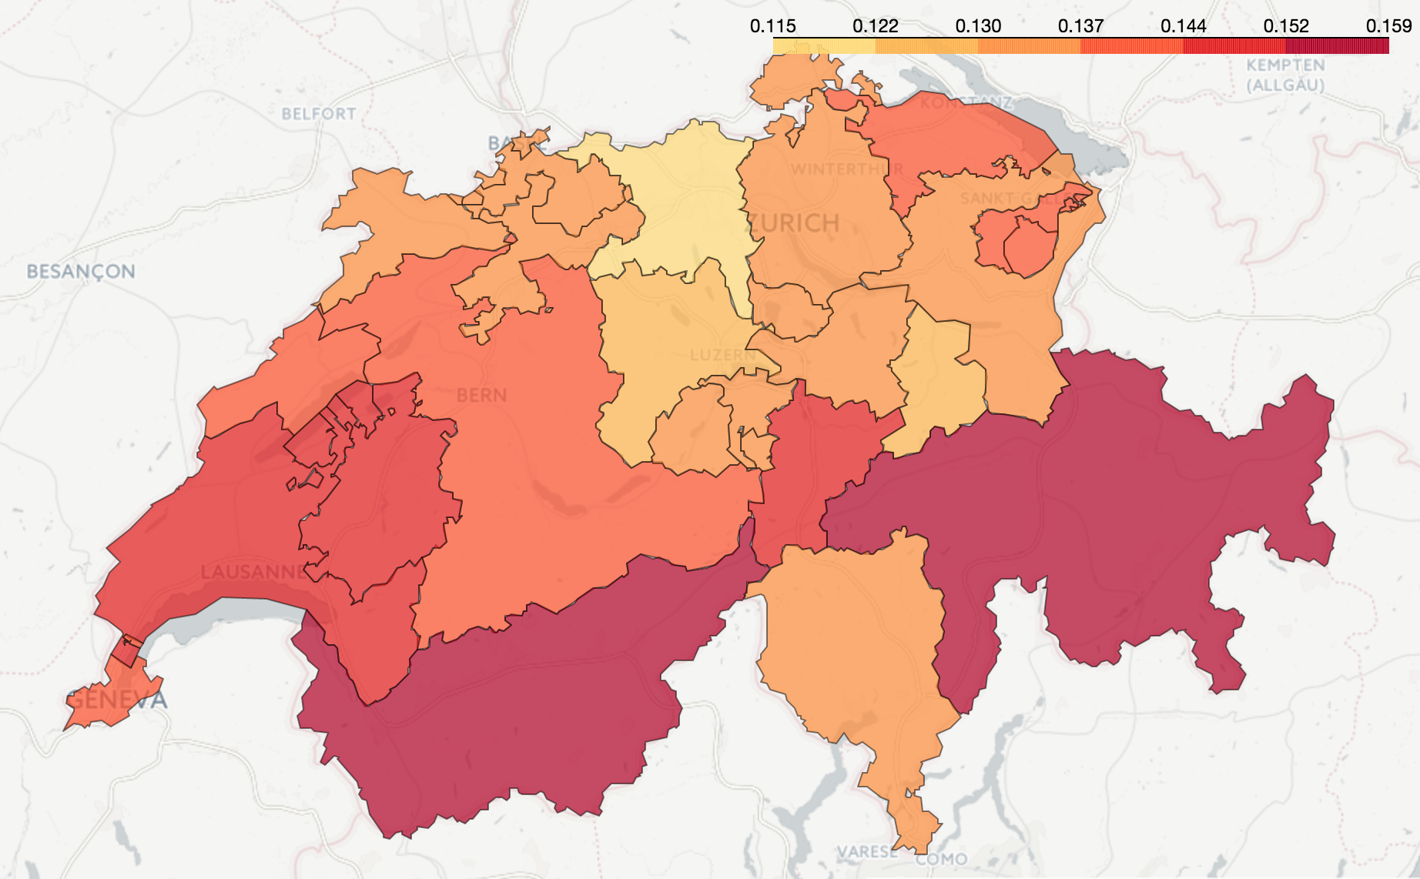

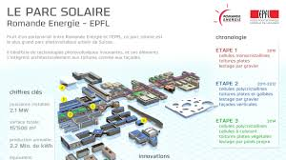

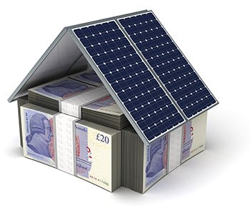



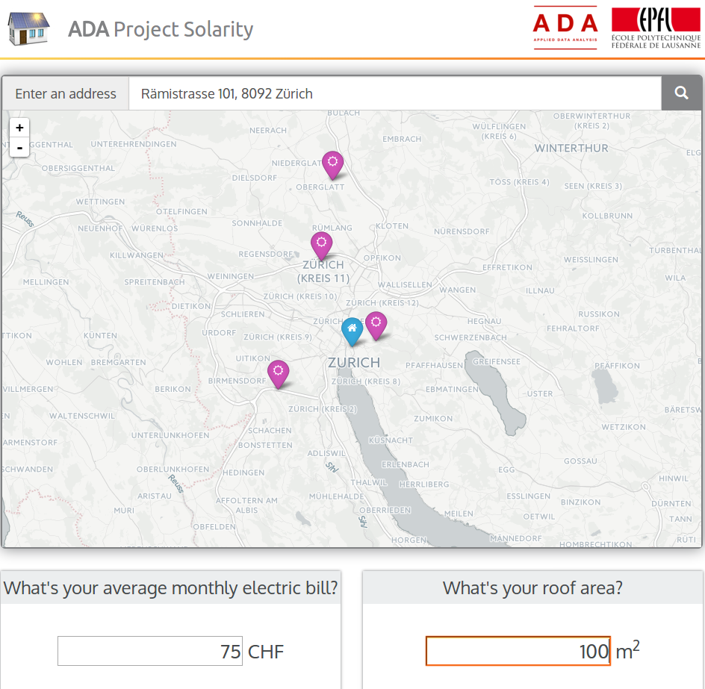
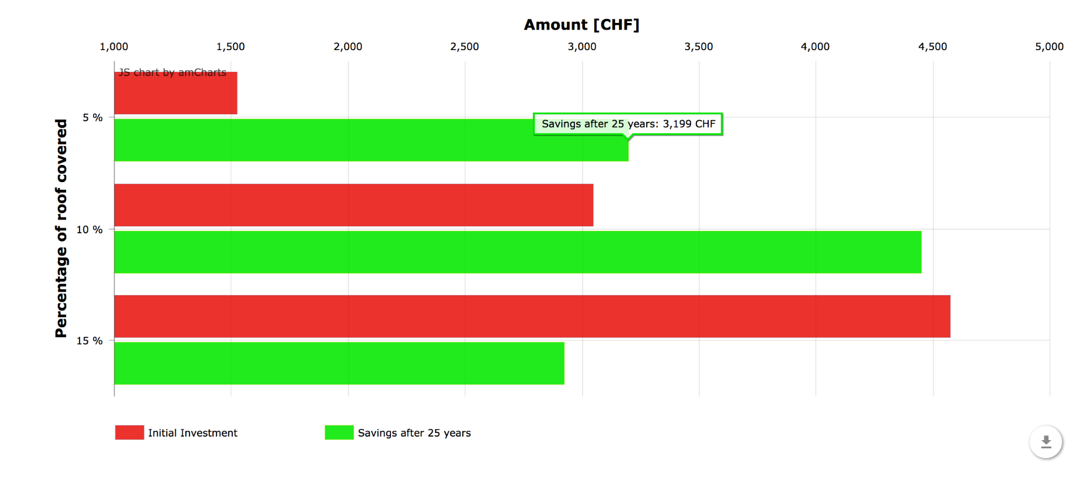
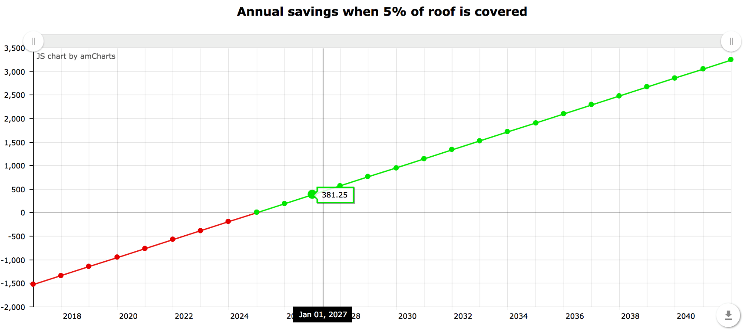
SCHOOL OF COMPUTER AND COMMUNICATION SCIENCES
Emanuele Bugliarello, Maaz Mohiuddin and Wajeb Saab
Solarity: Solar Clarity for Swiss Households
www.github.com/e-bug/solarity
What’s on Heidi’s Mind?
Heidi’s Input
Switzerland 2035
30-40% solar generation
Go Green!
Home Address
Monthly Electricity Bill
Approximate Roof Area
How many solar panels do I need?
How much does it cost?
How much do I save?
When do I break even?
Solarity: Under the Hood
Data Acquisition
Data Wrangling
Data Interpretation
Solar Irradiance (W/m²)
Temperature (˚C)
Wind Speed (m/s)
Stations-wise data
During 2000-2016
From 200 weather stations
No API: Developed web-scraper
Data for EPFL
Jan-July 2016
Locations of Weather Stations
Stations’ Locations
Stations’ Features
Solar production at EPFL
in Jan-July 2016 (W)
Regression Training Features to Solar Potential
Obtained through measurement campaign
Mean predicted Solar Potential per canton
Electricity and Solar tariffs (CHF)
From Utilities and Vendors
Predict Solar Potential (kW/m²)
Visualization
Initial Investment | 1525 CHF
Total Earnings (25 yrs) | 4724 CHF
Total Savings (25 yrs) | 3199 CHF
8 Years until Payback

